Slide 1
CSA-01
Huy Anh

Slide 2
Table of content
01
02
03
04
05
Introduction
Why I choose this topic
benefit of those charts
06
dashboard
conclusion
Q&A AND DEMO

Slide 3
INTRODUCTION
01
Introduction
Exploring the influence of self-study hours, extracurricular activities, and school attendance on student performance in subjects like chemistry and math helps educators create better learning environments.

Slide 4
Table of content
01
02
03
04
05
Introduction
Why I choose this topic
benefit of those charts
06
dashboard
conclusion
Q&A AND DEMO

Slide 5
This topic is selected because it offers insights into how various aspects of student life affect academic performance. It helps in: Developing Educational Policies: Guides policy-making to address diverse student needs. Supporting Research: Encourages a data-driven approach for educational improvement. Holistic Development: Promotes a balanced approach covering academic skills and personal development.
02
Why I choose this topic

Slide 6
Table of content
01
02
03
04
05
Introduction
Why I choose this topic
benefit of those charts
06
dashboard
conclusion
Q&A AND DEMO

Slide 7
03
benefit of those charts
Benefits
Enhanced Learning Plans:
Tailors learning to balance academic needs and personal growth.
Effective Support:
Higher Engagement:
Identifying how absences affect grades helps develop support systems to improve attendance.
More engaging school programs can boost student participation.

Slide 8
Table of content
01
02
03
04
05
Introduction
Why I choose this topic
benefit of those charts
06
dashboard
conclusion
Q&A AND DEMO

Slide 9

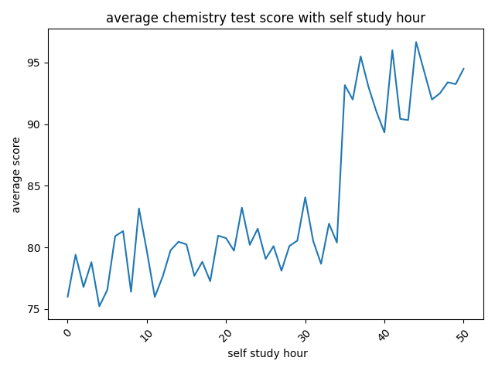
avg.chem score compare to how many hour they spend to self study
Highest Scores:
The highest scores are recorded when self-study hours are around 45-50 hours. This point on the graph indicates a peak level of performance correlating with the maximum self-study hours depicted.
Stability in Higher Hours:
Beyond approximately 30 hours of self-study, the average scores seem more stable and maintain higher values. The trend line becomes less erratic and mostly stays above 80.
In summary, the graph illustrates a general trend that more self-study hours can lead to better average test scores in chemistry

Slide 10
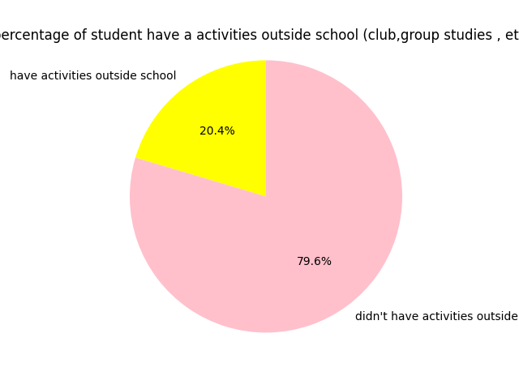
Majority Not Participating:
A substantial majority of the students, 79.6%, do not participate in any activities outside school. This indicates that a significant portion of students either may not have access to or are not interested in extracurricular activities.
Implications on Learning and Social Skills:
Involvement in activities outside of school is often linked to better social skills, higher self-esteem, and sometimes better academic performance due to diverse learning environments.

Slide 11
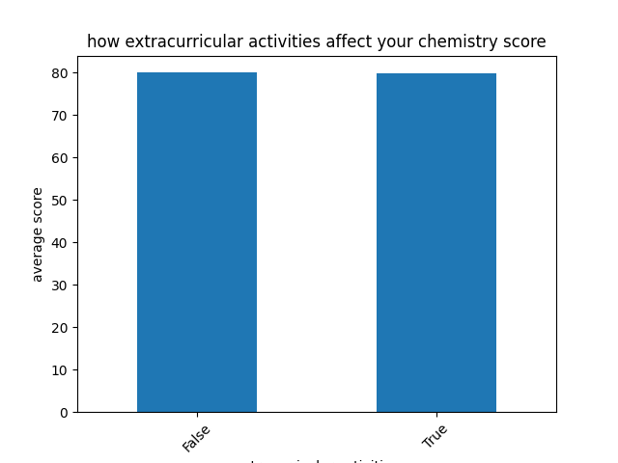
Impact of Extracurricular Activities on Chemistry Scores:
The graph compares the average chemistry scores of students who participate in extracurricular activities versus those who do not. The average score for students involved in activities is slightly lower than for those who aren't.
Link between Self-Study Hours and Extracurricular Participation:
Considering the line graph and pie chart, students spending more hours studying independently seem to achieve higher scores. However, the participation in extracurricular activities (from the bar graph) appears to slightly reduce the average score.
Impact of Extracurricular Activities :
Time Management: Students not participating in activities may have more time available for studying.
Focus and Fatigue: Those involved in activities might have divided attention or higher fatigue, potentially impacting study efficiency.
This link suggests that while self-study is critical, the role of extracurricular activities might be more complex, possibly offering benefits not directly measurable by test scores, such as enhanced social skills, teamwork, and time management abilities.

Slide 12
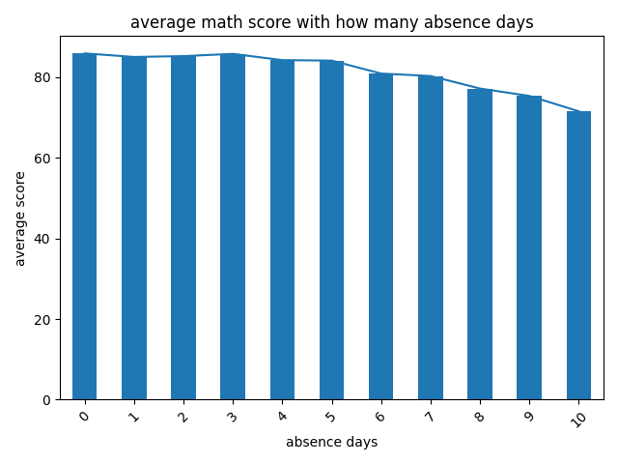
Average Math Score with Absence Days
Decreasing Trend:
There is a clear downward trend in average scores as absence days increase from 0 to 10.
This suggests that regular attendance plays a crucial role in achieving higher math scores. As students miss more school days, their scores tend to decline.
Potential Impact on Learning:
Missed classes likely result in gaps in learning, which could explain the gradual decrease in scores. Missing more days equates to missing more content, making it harder to keep up with new material.
In summary, the graph illustrates a general trend that more self-study hours can lead to better average test scores in chemistry

Slide 13
Table of content
01
02
03
04
05
Introduction
Why I choose this topic
benefit of those charts
06
dashboard
conclusion
Q&A AND DEMO

Slide 14
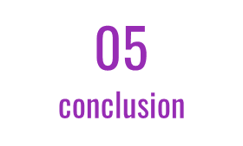
Overall Academic Impact: All graphs illustrate different aspects affecting academic performance. Regular attendance, as seen from the math score chart, is crucial, much like adequate self-study hours are for chemistry.
Extracurricular Activities: It's visible from the pie chart and the bar graph about extracurricular activities that engaging in such activities affects academic scores in a nuanced way. The bar graph illustrates a slight decrease in scores for students involved in extracurricular activities, suggesting possible time management challenges.
Comprehensive Insight:
Attendance: Steady attendance is indispensable, as seen in the math score trends.
Self-study: Significant self-study hours correlate with higher scores in chemistry, emphasizing the necessity of dedicated study time.
Balanced Involvement: Engagement in activities needs to be balanced. Although it slightly lowers academic scores, it could foster other skills beneficial in broader educational and career contexts.

Slide 15
Table of content
01
02
03
04
05
Introduction
Why I choose this topic
benefit of those charts
06
dashboard
conclusion
Q&A AND DEMO

Slide 16
Q&A AND DEMO
06
Q&A AND DEMO

Slide 17
THANKS

